Slide 1
Part 1 Overview
Chapter-1 Introduction

Slide 2
Objectives
We will provide
a grand tour of the major operating systems components
coverage of basic computer system organization
an overview of the many types of computing environments
To explore several open-source operating systems

Slide 3
Content
What is OS ( Operating System )?
What Operating Systems Do
Computer System Structure
Computer System Organization
Computer-System Architecture
OS Structure
OS Operations
OS Management
An overview of OS

Slide 4
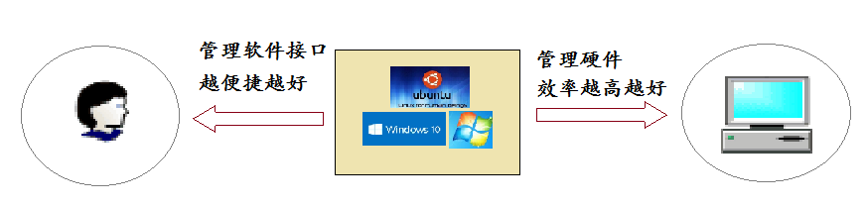
1.What is OS?
OS：A program that acts as an intermediary （媒介 ）between a user of a computer and the computer hardware
User view; System view
Goals of OS
  Execute user programs , make solving user problems easier
  Make the computer system convenient to use
  Use the computer hardware in an efficient manner
Example: Handheld computers are resource poor, optimized for usability and battery life

Slide 5
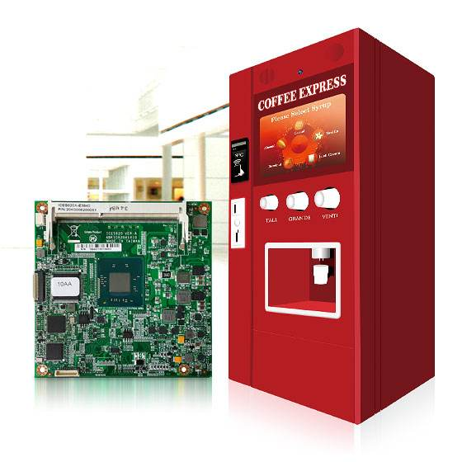
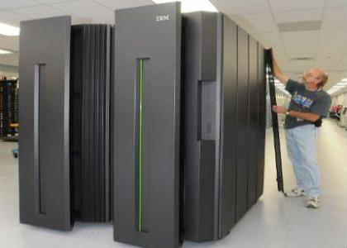
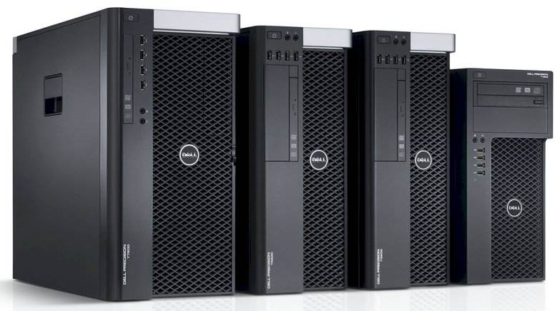
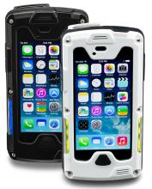
2. What Operating Systems Do
Users want convenience, ease of use and good performance
  Don’t care about resource utilization
Handheld
computers
embedded
computers
mainframe or
minicomputer
workstations
大型机或小型计算机让所有用户满意
专用资源经常共享在服务器上
手持电脑资源轻量，优化提高电池持续时间
有些计算机几乎没有用户界面，例如汽车中的嵌入式计算机

Slide 6
2. What Operating Systems Do
Computer system can be divided into four components:
  Hardware –- CPU, memory, I/O devices
  Operating system –– Unix,Windows2000
  Application programs –– Word processors, web browsers, database systems
  Users –– People, machines, other computers

Slide 7
3. Computer System Structure
End User
Programmers
Operating
System
Applications Programs
Designer
Utilities (Compiler, Database
…
)
Operating System
Computer Hardware
Layers and Views of a Computer System

Slide 8
From two viewpoints:
（1） User View
（2）System View

Slide 9
（1） User View
Users want convenience——ease of use
  Don’t care about resource utilization
Users shared in mainframe or minicomputer--- keep all users happy
Users of workstations ——frequently use shared resources from servers
Notes:
Users want convenience, ease of use
Don’t care about resource utilization
But shared computer such as mainframe or minicomputer must keep all users happy
Users of dedicate systems such as workstations have dedicated resources but frequently use shared resources from servers

Slide 10
（2）System View
OS is a resource allocator
  Manages all resources
  Solve conflicting requests for resource request
OS is a control program
  Controls execution of programs
  prevent errors and improper（不当） use of the computer
Notes:
OS is a resource allocator
Manages all resources
Decides between conflicting requests for efficient and fair resource use
OS is a control program
Controls execution of programs to prevent errors and improper use of the computer

Slide 11
Operating System Definition
“The one program running at all times on the computer” is the kernel.
Everything else is either a system program (ships with the operating system) or an application program.
Notes:
No universally accepted definition：
“Everything a vendor ships when you order an operating system” is good approximation
But varies wildly
“The one program running at all times on the computer” is the kernel. Everything else is either a system program (ships with the operating system) or an application program.

Slide 12
4.Computer System Organization
（1）Computer-system operation
（2）Storage Structure
（3）I/O Structure

Slide 13

（1）Computer-system operation
One or more CPUs, device controllers accessing to shared memory
Concurrent execution of CPUs and devices competing for memory cycles
shared memory
common bus
Notes:
I/O devices and the CPU can execute concurrently
Each device controller is in charge of a particular device type
Each device controller has a local buffer
CPU moves data from/to main memory to/from local buffers
I/O is from the device to local buffer of controller
Device controller informs CPU that it has finished its operation by causing an interrupt

Slide 14
Two main operations
Computer Startup
Interrupts

Slide 15
Computer Startup
bootstrap program is loaded at power-up or reboot
  Typically stored in ROM or EPROM, generally known as firmware
  It initializes all aspects of system: CPU registers; device controllers ;memory contents
  Locate and Loads operating system kernel into memory and starts execution

Slide 16
Interrupts
Two types
  External event
    I/O interrupt, external interrupt
  Internal interrupt ( trap)
    Hardware fault interrupt,
    the program interruptions
    visit pipe break

Slide 17
说明
外部中断
  指由计算机外设发出的中断请求，如：键盘中断、打印机中断、定时器中断等。
  外部中断是可以屏蔽的中断，也就是说，利用中断控制器可以屏蔽这些外部设备的中断请求
内部中断
  因硬件出错（如突然掉电、奇偶校验错等）或运算出错（除数为零、运算 溢出、单步中断等）所引起的中断。
  内部中断是不可屏蔽的中断。

Slide 18

Device-Status Table

Slide 19
Interrupts
Idea:
I/O can be completed asynchronously
Trap: Software-generated interrupt caused either by an error or a user request.
  An OS is interrupt-driven
Notes:
Observations:
The behavior of programs: “compute, I/O, compute, ...”
CPU is much faster than I/O
Must CPU wait when I/O is processing?
CPU time is expensive!
Idea: I/O can be completed asynchronously
Idea: Trap: Software-generated interrupt caused either by an error or a user request.
An OS is interrupt-driven

Slide 20
Computer-System Operation
Each device controller is in charge of a particular device type.
Each device controller has a local buffer.
CPU moves data between main memory and local buffers
I/O is from the device to local buffer of controller.
Device controller informs CPU that it has finished its operation by causing an interrupt.

Slide 21
Common Functions of Interrupts
Interrupt transfers through the interrupt vector
save the address of the interrupted instruction.
Incoming interrupts are disabled while another interrupt is being processed(在处理另一中断时禁用传入中断)
A trap is a software-generated interrupt caused either by an error or a user request.
An operating system is interrupt driven.
Notes:
Interrupt transfers control to the interrupt service routine generally, through the interrupt vector, which contains the addresses of all the service routines.
Interrupt architecture must save the address of the interrupted instruction.
Incoming interrupts are disabled while another interrupt is being processed to prevent a lost interrupt.
A trap is a software-generated interrupt caused either by an error or a user request.
An operating system is interrupt driven.

Slide 22
Interrupt Handling
Preserves CPU state by storing registers and the program counter.
Determines which type of interrupt
  polling轮询
  vectored interrupt system矢量化中断系统
Separate segments of code and determine action
Notes:
The operating system preserves the state of the CPU by storing registers and the program counter.
Determines which type of interrupt has occurred:
polling
vectored interrupt system
Separate segments of code determine what action should be taken for each type of interrupt

Slide 23

Interrupt Timeline
Interrupt Time Line For a Single Process of Output

Slide 24
(2)Storage Structure
Main memory ––– large storage, only CPU access directly
Secondary storage ––– extension of main memory, large nonvolatile storage
Magnetic disks ––– metal covered with magnetic material
  Surface is divided into tracks ,further sectors
  The disk controller determines interaction
Notes:
Main memory – only large storage media that the CPU can access directly. (RAM and ROM)
Memory is a large array of words or bytes, each with its own address. It is a repository of quickly accessible data shared by the CPU and I/O devices.
Main memory is a volatile storage device(易失忆性存储设备). It loses its contents in the case of system failure.
Secondary storage – extension of main memory that provides large nonvolatile storage(非失忆性存储) capacity.
Since main memory is volatile and too small to accommodate all data and programs permanently, the computer system must provide secondary storage to back up main memory.
Magnetic disks – rigid metal or glass platters covered with magnetic recording material
Disk surface is logically divided into tracks(磁道), which are subdivided into sectors(扇面).
The disk controller determines the logical interaction between the device and the computer.

Slide 25
Storage Hierarchy
Storage systems organized in hierarchy.
  Speed
  Cost
  Volatility易失性

Slide 26
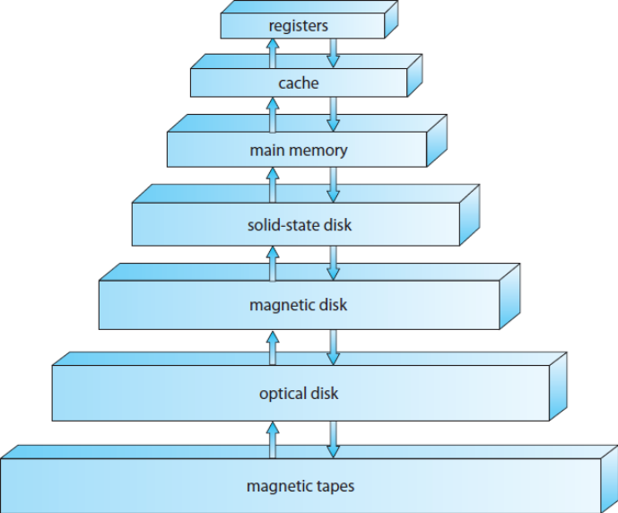
Storage-Device Hierarchy
high speed
low price
large volume

Slide 27
Storage Hierarchy
Caching缓存 – copying information into faster storage system; main memory can be viewed as a last cache for secondary storage.
Important principle, performed at many levels in a computer (in hardware, operating system, software)
Information in use copied from slower to faster storage temporarily

Slide 28
Caching
Faster storage (cache) checked first to determine if information is there
  If it is, information used directly from the cache (fast)
  If not, data copied to cache and used there
Cache smaller than storage being cached
  Cache management important design problem
  Cache size and replacement policy

Slide 29
Storage Structure
Hard disks – rigid metal or glass platters covered with magnetic recording material
  Disk surface is logically divided into tracks, which are subdivided into sectors
  The disk controller determines the logical interaction between the device and the computer
Solid-state disks – faster than hard disks, nonvolatile
  Various technologies
  Becoming more popular

Slide 30
Solid-state disks
固态硬盘（Solid State Drive）用固态电子存储芯片阵列而制成的硬盘，由控制单元和存储单元（FLASH芯片、DRAM芯片）组成。
存储介质分为两种：闪存（FLASH芯片）和DRAM
  基于闪存类FLASH芯片：基于闪存的固态硬盘,采用FLASH芯片作为存储介质，这也是通常所说的SSD。
  基于DRAM的固态硬盘：应用范围较窄。仿效传统硬盘的设计，可由绝大部分操作系统的文件系统工具进行卷设置和管理

Slide 31
Storage Structure
Device Driver for each device controller to manage I/O
  Provides uniform interface between controller and kernel

Slide 32
（3）I/O Structure
Two Methods I/O
  Synchronous
    After I/O starts, control returns to user program only upon I/O completion.
  Asynchronous
    After I/O starts, control returns to user program without waiting for I/O completion.
Notes:
有两种类型的IO同步：
同步IO
异步IO。
异步IO也就是重叠IO。在同步IO中，线程启动一个IO操作然后就立即进入等待状态，直到IO操作完成后才醒来继续执行。
异步IO方式中，线程发送一个IO请求到内核，然后继续处理其他的事情，内核完成IO请求后，将会通知线程IO操作完成了。
如果IO请求需要大量时间执行的话，异步文件IO方式可以显著提高效率，因为在线程等待的这段时间内，CPU将会调度其他线程进行执行，如果没有其他线程需要执行的话，这段时间将会浪费掉（可能会调度操作系统的零页线程）。
如果IO请求操作很快，用异步IO方式反而还低效，还不如用同步IO方式。
同步IO在同一时刻只允许一个IO操作，也就是说对于同一个文件句柄的IO操作是序列化的，即使使用两个线程也不能同时对同一个文件句柄同时发出读写操作。重叠IO允许一个或多个线程同时发出IO请求。
异步IO在请求完成时，通过将文件句柄设为有信号状态来通知应用程序，或者应用程序通过GetOverlappedResult察看IO请求是否完成，也可以通过一个事件对象来通知应用程序。
简单的说,同步在编程里，一般是指某个IO操作执行完后，才可以执行后面的操作。异步则是，将某个操作给系统，主线程去忙别的事情，等内核完成操作后通知主线程异步操作已经完成。”

Slide 33
同步IO和异步IO
同步IO：也就是重叠IO
  在同步文件IO中，线程启动一个IO操作然后就立即进入等待状态，直到IO操作完成后才醒来继续执行。
异步IO方式：
  线程发送一个IO请求到内核，然后继续处理其他的事情，内核完成IO请求后，将会通知线程IO操作完成了

Slide 34

Two I/O Methods
Synchronous
Asynchronous

Slide 35

How a Modern Computer Works
A von Neumann architecture

Slide 36
Direct Memory Access Structure
Used for high-speed I/O devices able to transmit information at close to memory speeds
Device controller transfers blocks of data from buffer storage directly to main memory without CPU intervention
Only one interrupt is generated per block, rather than the one interrupt per byte
Notes:
Used for high-speed I/O devices able to transmit information at close to memory speeds.
Device controller transfers blocks of data from buffer storage directly to main memory without CPU intervention.
Only one interrupt is generated per block, rather than the one interrupt per byte.
原因：即使采用异步中断方式，高速的I/O设备也会占用CPU大量的时间，所以使用直接内存访问技术。
中断I/O：CPU“字节”干预一次，即每“字节”传送产生一次中断。
DMA：由DMA控制器直接控制总线传递数据块。DMA控制器完成从I/O——内存。

Slide 37
6. Computer-System Architecture
（1） a single processor and Multiprocessors
  a single processor throughput: Most systems use a single general-purpose processor
  Multiprocessors systems growing in use and importance
    Also known as parallel systems, tightly-coupled systems
    Advantages include: Increased throughput; Economy of scale; Increased reliability
Notes:
Most systems use a single general-purpose processor (PDAs through mainframes)
Most systems have special-purpose processors as well
Multiprocessors systems growing in use and importance
Also known as parallel systems, tightly-coupled systems
Advantages include:
Increased throughput
Economy of scale
Increased reliability – graceful degradation or fault tolerance
Two types:
Asymmetric Multiprocessing
Symmetric Multiprocessing

Slide 38
Computer-System Architecture
Two types of Multiprocessors systems
Asymmetric Multiprocessing – each processor is assigned a special task
Symmetric Multiprocessing – each processor performs all tasks
Notes:
Most systems use a single general-purpose processor (PDAs through mainframes)
Most systems have special-purpose processors as well
Multiprocessors systems growing in use and importance
Also known as parallel systems, tightly-coupled systems
Advantages include:
Increased throughput
Economy of scale
Increased reliability – graceful degradation or fault tolerance
Two types:
Asymmetric Multiprocessing
Symmetric Multiprocessing

Slide 39

(2)Symmetric Multiprocessing Architecture

Slide 40

(3)A Dual-Core Design
Multi-chip and multicore
Systems containing all chips
  Chassis containing multiple separate systems

Slide 41
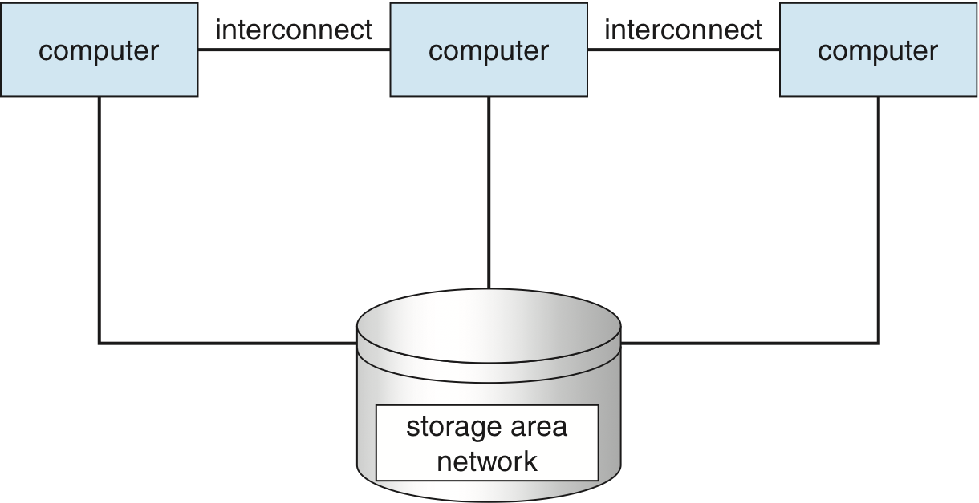
（4）Clustered Systems

Slide 42
Clustered Systems
双机热备
高可用性软件将自动地把服务转到另一台服务器上，从而让服务持续可用。对系统服务故障恢复。
及时监控服务器状况并将故障机的工作以最快的速度切换至备用服务器上运行，保证数据和业务的连续性
Like multiprocessor systems, but multiple systems working together
  Usually sharing storage via a storage-area network (SAN)
  Provides a high-availability service which survives failures
    Asymmetric clustering has one machine in hot-standby mode
    Symmetric clustering has multiple nodes running applications, monitoring each other
  Some clusters are for high-performance computing (HPC)
    Applications must be written to use parallelization
  Some have distributed lock manager (DLM) to avoid conflicting operations

Slide 43
7.OS Structure
Multiprogramming
  organizes jobs (code and data) so CPU always has one to execute
(2)Timesharing (multitasking)
  If several jobs ready to run at the same time  CPU scheduling
  Virtual memory allows execution of processes not completely in memory
Notes:
Multiprogramming needed for efficiency
Single user cannot keep CPU and I/O devices busy at all times
Multiprogramming organizes jobs (code and data) so CPU always has one to execute
A subset of total jobs in system is kept in memory
One job selected and run via job scheduling
When it has to wait (for I/O for example), OS switches to another job
Timesharing (multitasking) is logical extension in which CPU switches jobs so frequently that users can interact with each job while it is running, creating interactive computing
Response time should be < 1 second
Each user has at least one program executing in memory process
If several jobs ready to run at the same time  CPU scheduling
If processes don’t fit in memory, swapping moves them in and out to run
Virtual memory allows execution of processes not completely in memory

Slide 44
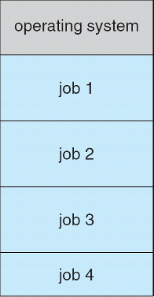
Memory Layout for Multiprogrammed System
0
512M

Slide 45
8. OS Operations
Interrupt driven by hardware
Software error or request creates exception or trap
  Division by zero, request for operating system service
Other process problems include infinite loop, processes modifying each other or the operating system

Slide 46
8. OS Operations (Cont’d)
Dual-mode operation:
  User mode
  kernel mode
Mode bit provided by hardware
    Some instructions designated as privileged, only executable in kernel mode
    System call changes mode to kernel, return from call resets it to user: kernel→ user
Notes:
Interrupt driven by hardware
Software error or request creates exception or trap
Division by zero, request for operating system service
Other process problems include infinite loop, processes modifying each other or the operating system
Dual-mode operation:
User mode
kernel mode
Mode bit provided by hardware
Provides ability to distinguish when system is running user code or kernel code
Some instructions designated as privileged, only executable in kernel mode
System call changes mode to kernel, return from call resets it to user

Slide 47

Transition from User to Kernel Mode
Timer to prevent infinite loop / process hogging resources
  Timer is set to interrupt the computer after some time period
  Keep a counter that is decremented by the physical clock.
  Operating system set the counter (privileged instruction)
  When counter zero generate an interrupt
  Set up before scheduling process to regain control or terminate program that exceeds allotted time

Slide 48
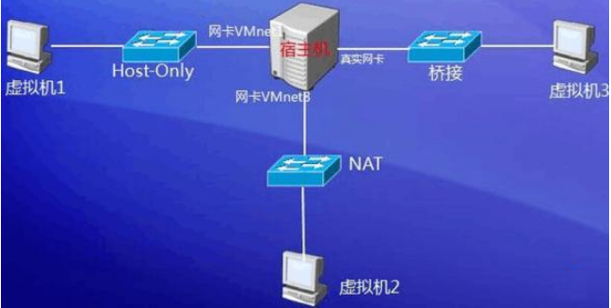
8. OS Operations (Cont’d)
Increasingly CPUs support multi-mode operations
  i.e. virtual machine manager (VMM) mode for guest VMs

Slide 49
9. OS Management
Process Management:
  Process needs resources to accomplish its task: CPU, memory, I/O, files; Initialization data
  Typically system has many processes, some user, some operating system running concurrently on one or more CPU
  Concurrency by multiplexing the CPUs among the processes / threads

Slide 50
OS Management
Memory Management:
  To execute a program all (or part) of the instructions must be in memory
  Keeping track of which parts of memory are currently being used and by whom
  Deciding which processes and data to move into and out of memory
  Allocating and deallocating memory space as needed

Slide 51
OS Management
Storage Management:
  Each medium is controlled by device (i.e., disk drive, tape drive)
    Varying properties include access speed, capacity, data-transfer rate, access method (sequential or random)
  File-System management: Access control on most systems to determine who can access what

Slide 52
OS Management
Mass-Storage :
  Usually disks used to store data that does not fit in main memory or data that must be kept for a “long” period of time
  Entire speed of computer operation hinges on disk subsystem and its algorithms
  OS activities
    Free-space management
    Storage allocation
    Disk scheduling

Slide 53
OS Management
Protection and Security :
  Protection – any mechanism for controlling access of processes or users to resources defined by the OS
  Security – defense of the system against internal and external attacks : denial-of-service, worms, viruses, theft of service
  Systems generally first distinguish among users:
    User identities (user IDs, security IDs)
    User ID then associated with all files
    Group identifier (group ID) allows set of users to be defined and controls managed, then also associated with each process, file

Slide 54
10. Computing Environments
Traditional
  Stand-alone general purpose machines
  Portals provide web access to internal systems
  Network computers (thin clients) are like Web terminals
  Mobile computers interconnect via wireless networks
  Networking becoming ubiquitous – even home systems use firewalls to protect home computers from Internet attacks

Slide 55
Computing Environments (Cont’)
Mobile
  Handheld smart-phones, tablets, PDAs, etc
  Extra feature – more OS features (GPS, gyroscope)
  Allows new types of apps like augmented reality
  Use IEEE 802.11 wireless, or cellular data networks for connectivity
  Leaders are Apple iOS and Google Android
  limited CPU, memory, power,Reduced feature set OS, limited I/O

Slide 56
Computing Environments (Cont’)
Distributed
  Collection of separate, possibly heterogeneous, systems networked together
    Network is a communications path, TCP/IP most common
    Local Area Network (LAN)
    Wide Area Network (WAN)
    Metropolitan Area Network (MAN)
    Personal Area Network (PAN)
  Network Operating System provides features between systems across network
    Communication scheme allows systems to exchange messages
    Illusion of a single system

Slide 57

Computing Environments (Cont’)
Client-Server
  Client-Server Computing
    Dumb terminals supplanted by smart PCs
    Many systems now servers, responding to requests generated by clients
      Compute-server system provides an interface to client to request services (i.e., database)
      File-server system provides interface for clients to store and retrieve files

Slide 58

Computing Environments (Cont’)
Peer-to-Peer
  P2P does not distinguish clients and servers
    Instead all nodes are considered peers
    May each act as client, server or both
    Node must join P2P network
      Broadcast request for service and respond to requests for service via discovery protocol
  Examples include Napster and Gnutella, Voice over IP (VoIP) such as Skype
一款P2P的典型软件，可以在网络中下载交换音乐文件软件
Gnutella2 is a peer-to-peer protocol developed in 2002.

Slide 59
Computing Environments (Cont’)
Virtualization
  Allows operating systems to run applications within other OSes: Vast and growing industry
  Emulation used when source CPU type different from target type (i.e. PowerPC to Intel x86)
  VMM (virtual machine Manager) provides virtualization services: VMware, openstack

Slide 60

Computing Environments - Virtualization

Slide 61
Computing Environments - Virtualization
A virtual machine takes the layered approach to its logical conclusion.
  It treats hardware and the operating system kernel as though they were all hardware.
  A virtual machine provides an interface identical to the underlying bare hardware.
  The operating system host creates the illusion that a process has its own processor and (virtual memory).
Notes:
Java虚拟机是一个虚拟机器,在实际的计算机上通过软件模拟来实现。
Java虚拟机有自己想象中的硬件,如处理器、堆栈、寄存器等,还具有相应的指令系统。
为什么要使用Java虚拟机 ?
Java语言与平台的无关性。而使用Java虚拟机是实现这一特点的关键。一般的高级语言如果要在不同的平台上运行,至少需要编译成不同的目标代码。而引入Java语言虚拟机后,Java语言在不同平台上运行时不需要重新编译。Java语言使用模式Java虚拟机屏蔽了与具体平台相关的信息
Java语言编译程序只需生成在Java虚拟机上运行的目标代码(字节码),就可以在多种平台上不加修改地运行。
Java虚拟机体系结构 Java虚拟机由五个部分组成:一组指令集、一组寄存器、一个栈、一个无用单元收集堆(Garbage-collected-heap)、一个方法区域。这五部分是Java虚拟机的逻辑成份,不依赖任何实现技术或组织方式,但它们的功能必须在真实机器上以某种方式实现。

Slide 62
System Structure
The resources of the physical computer are shared to create the virtual machines.
  CPU scheduling can create the appearance that users have their own processor.
  Spooling and a file system can provide virtual card readers and virtual line printers.
  A normal user time-sharing terminal serves as the virtual machine operator’s console.

Slide 63
Virtual Machines (Cont.)
Advantages/Disadvantages
  The virtual-machine concept provides complete protection of system resources
  since each virtual machine is isolated from all other virtual machines.This isolation, however, permits no direct sharing of resources.

Slide 64
Virtual Machines (Cont.)
A virtual-machine system is a perfect vehicle for operating-systems research and development.
Instead of on a physical machine and so does not disrupt normal system operation.
The virtual machine concept is difficult to implement due to the effort required to provide an exact duplicate to the underlying machine.

Slide 65
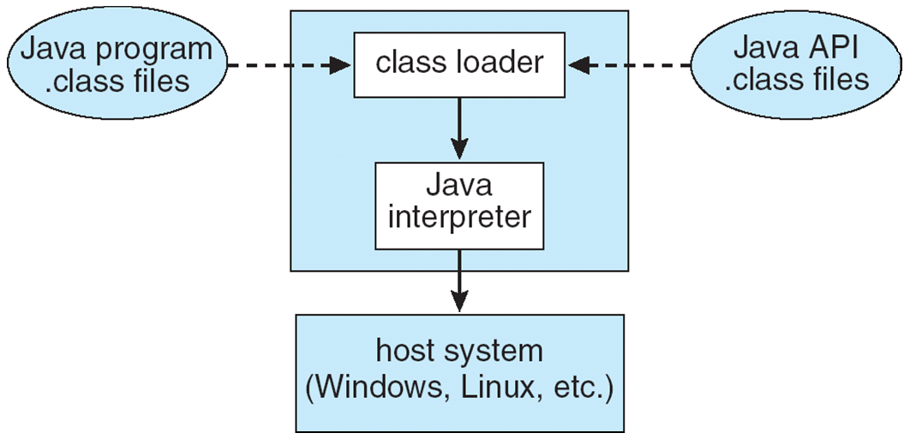
The Java Virtual Machine

Slide 66
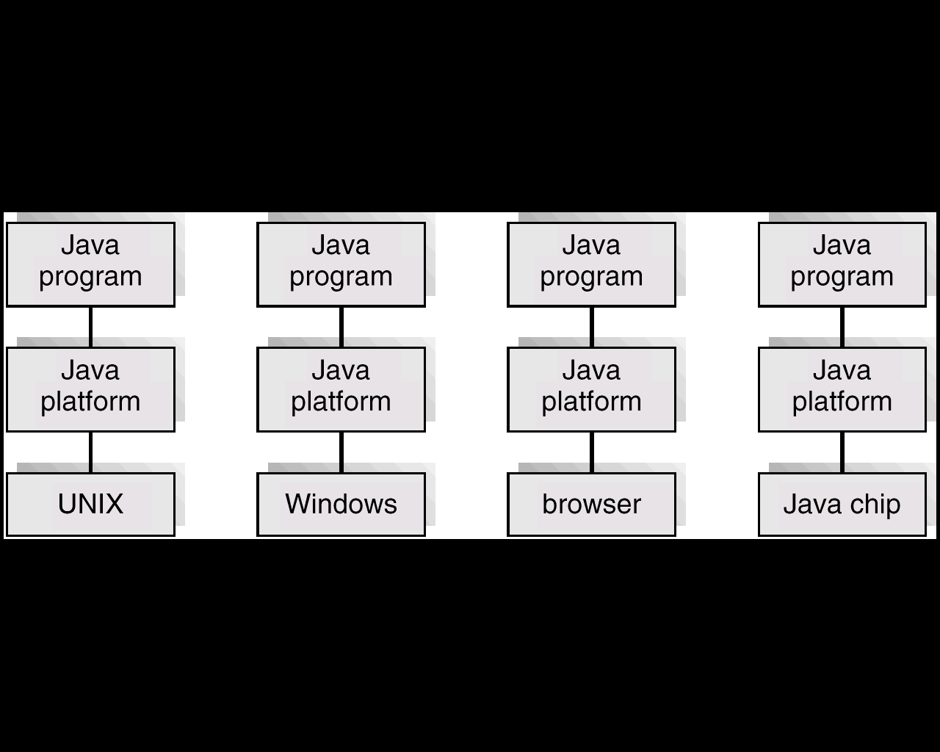
The Java Platform

Slide 67
Computing Environments – Cloud Computing
Delivers computing, storage, even apps as a service across a network
Logical extension of virtualization because it uses virtualization as the base for it functionality.
  Amazon EC2 has thousands of servers, millions of virtual machines, petabytes of storage available across the Internet, pay based on usage

Slide 68
Computing Environments – Cloud Computing
Many types
  Public cloud – available via Internet to anyone willing to pay
  Private cloud – run by a company for the company’s own use
  Hybrid cloud – includes both public and private cloud components
  Software as a Service (SaaS)
    – one or more applications available via the Internet (i.e., word processor)
  Platform as a Service (PaaS)
    – software stack ready for application use via the Internet (i.e., a database server)
  Infrastructure as a Service (IaaS)
    – servers or storage available over Internet (i.e., storage available for backup use)

Slide 69

Computing Environments – Cloud Computing
Cloud computing environments composed of traditional OSes, plus VMMs, plus cloud management tools
  Internet connectivity requires security like firewalls
  Load balancers spread traffic across multiple applications

Slide 70
Computing Environments – Real-Time Embedded Systems
Real-time embedded systems most prevalent form of computers
  Vary considerable, special purpose, limited purpose OS, real-time OS
  Use expanding
Many other special computing environments as well
  Some have OSes, some perform tasks without an OS
Real-time OS has well-defined fixed time constraints
  Processing must be done within constraint
  Correct operation only if constraints met

Slide 71
11. Open-Source Operating Systems
Operating systems made available in source-code format rather than just binary closed-source
Started by Free Software Foundation (FSF), which has “copyleft” GNU Public License (GPL)
Examples include GNU/Linux and BSD UNIX (including core of Mac OS X), and many more
Can use VMM like VMware Player (Free on Windows), Virtualbox (open source and free on many platforms -ttp://www.virtualbox.com)
  Use to run guest operating systems for exploration

Slide 72
OS Type
Single-user os
Mobile os
Batch System
Time-sharing system
Real-Time Systems
Network os
Multiprocessor os

Slide 73
Terms
Multiprogramming: 多道程序
Time-sharing: 分时
Thrashing: 颠簸
Personal Computer (PC): 个人电脑
Distributed Systems/OS: 分布式系统／操作系统
Network OS: 网络操作系统
Real-time: 实时
Embedded system: 嵌入式系统
Client-Server (C/S): 客户机／服务器
Peer-to-Peer (P2P): 对等
System-call: 系统调用
Micro-kernel: 微内核
kernel/user mode: 管态／目态，内核态／用户态
Application Program Interface (API): 应用程序接口
Policy: 策略
Mechanism: 机制
Operating Systems (OS): 操作系统
Kernel: 内核
Virtual machine: 虚拟机
Moore's Law: 摩尔定律
Batch: 批处理
Monitor: 监控器
Interrupt: 中断
Interrupt handling: 中断处理
Trap: 自陷／陷入

Slide 74
Homework
Read Chapter 1
Exercise-01

